Slide 1
M6
Which circuit will have more open-circuit voltage noise across its terminals?
1 k
2 k
top
bottom
they are the same
3 k

Slide 2
M6
Compute the open-circuit voltage noise across the terminals. Both resistors are at 300K.
12 k
1 nV/√Hz
5 nV/√Hz
10 nV/√Hz
20 nV/√Hz
50 nV/√Hz
12 k

Slide 3
M6
Suppose the top resistor is at 300 K and the bottom resistor is at 0 K. Compute the current noise in the circuit.
6 k
1 fA/√Hz
50 fA/√Hz
1 pA/√Hz
20 pA/√Hz
500 pA/√Hz
4 k

Slide 4
M6
Suppose the top resistor is at 300 K. Compute the current noise in the circuit.
6 k
1.7 pA/√Hz
36 fA/√Hz
5 pA/√Hz
17 pA/√Hz
360 pA/√Hz

Slide 5
M6
Suppose i_{n} = 1.66 pA /√Hz. Compute the voltage noise across the resistor due only to the current noise generator.
1 nV/√Hz
5 nV/√Hz
10 nV/√Hz
14 nV/√Hz
35 nV/√Hz
i_{n}
6 k
*

Slide 6
M6
Suppose i_{n} = 1.66 pA /√Hz. Compute the voltage noise across the resistor due to the current noise generator and the resistor’s thermal noise.
1 nV/√Hz
5 nV/√Hz
10 nV/√Hz
14 nV/√Hz
35 nV/√Hz
i_{n}
6 k
*

Slide 7
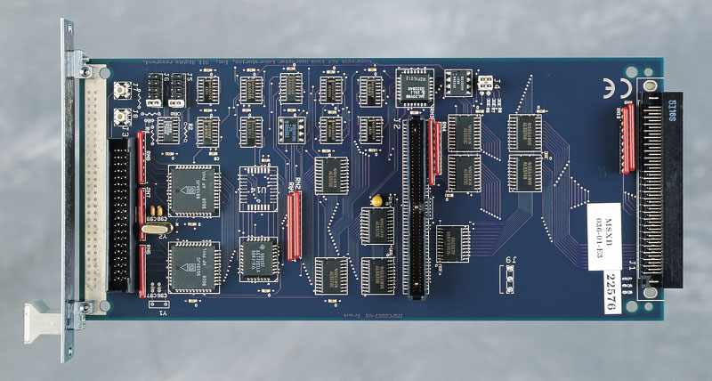
Digital Logic

Slide 8
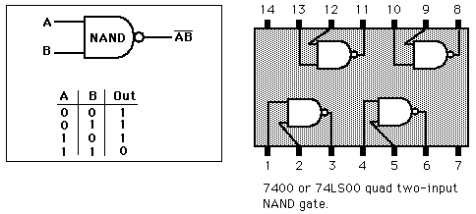

Slide 9
N1
What is the truth table for a NOR gate?
A B | A+B
0 0 | 0
0 1 | 1
1 0 | 1
1 1 | 1
B)
A B | A+B
0 0 | 1
0 1 | 0
1 0 | 0
1 1 | 0
C)
A B | A+B
0 0 | 1
0 1 | 0
1 0 | 0
1 1 | 1
D)
A B | A+B
0 0 | 0
0 1 | 1
1 0 | 1
1 1 | 0
E)
A B | A+B
0 0 | 0
0 1 | 0
1 0 | 0
1 1 | 1

Slide 10
N4
A● 0 =
0
1
A
A

Slide 11
N5
A● 1 =
0
1
A
A

Slide 12
N6
A● A =
0
1
A
A

Slide 13
N7
A● A =
0
1
A
A

Slide 14
N8
A● (A+B) =
0
1
A
B
A+(A ●B)

Slide 15
N8
A● (A+B) =
1
A● B
A+B
A●B
A+(A ●B)

Slide 16
N8
B ● (A ● B) =
1
A● B
A+B
A●B
A+(A ●B)

